Slide 1
Run Chart and Control chart
Course: IT Project Management
Presented by Han Chandeth

Slide 2
content
Control Chart
Introduction to control chart
What is a control chart?
Types of control chart
When to use control chart?
Benefits of control chart
Run Chart
History of run chart
What is run chart?
What does run chart look like?
Components of a run chart
Interpreting a runchart

Slide 3
Introduction to control chart
During a continuous manufacturing process, we want to know whether the process is in control or not and to know if there is any presence of variation. Variation may be due to chance or assignable causes. Control charts help to detect the causes during a process. It prevents us from manufacturing defective product and further. For example, variation can be in material properties, improper test procedure, etc.
Control chart was introduced by Dr. Walter A. Shewhart to control and monitor the process variation. This chart is also known as the Shewhart chart.

Slide 4
What is a control chart?
A control chart is a graph which displays all the process data in order sequence. It consists of a centre line, the upper limit and lower limit. Centre line of a chart represents the process average. Control limits (upper & lower) which are in a horizontal line below and above the centre line depicts whether the process is in control or out of control. Control limits are based on process variation.

Slide 5
Type of control chart
1. Attribute data – When your data is in the form of an attribute or count form of data we will use control charts like
P chart
U chart
C chart
Attribute data are the number of defects, defective units, etc.
2. Numerical data – When your data is in the form of a continuous type of data we will use control charts like
X bar chart
R bar chart
S bar chart
Examples like measurement of length, weight, temperature, etc.

Slide 6
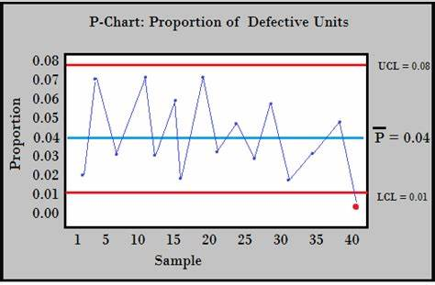
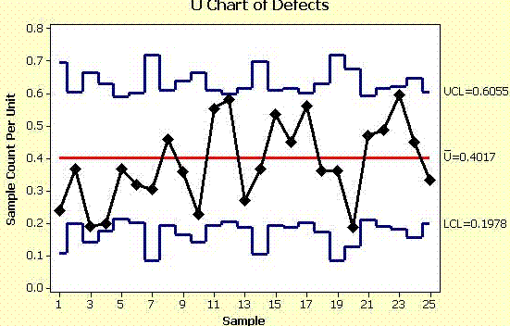
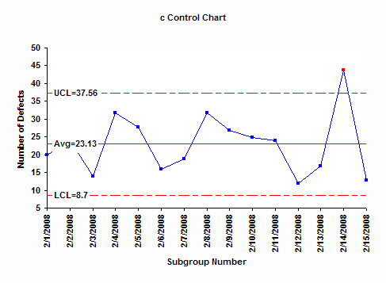
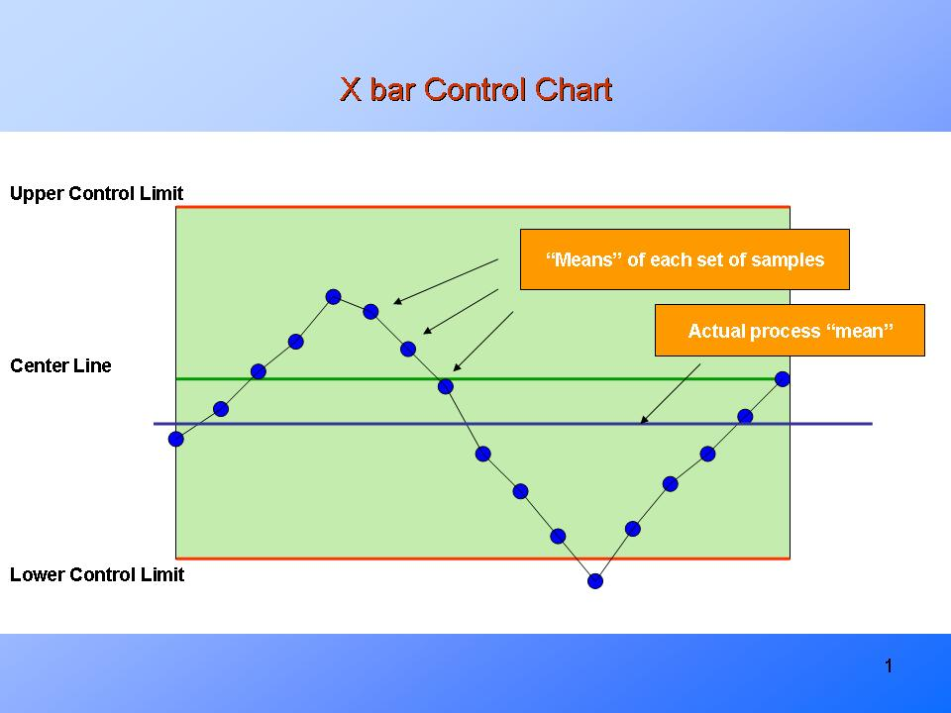
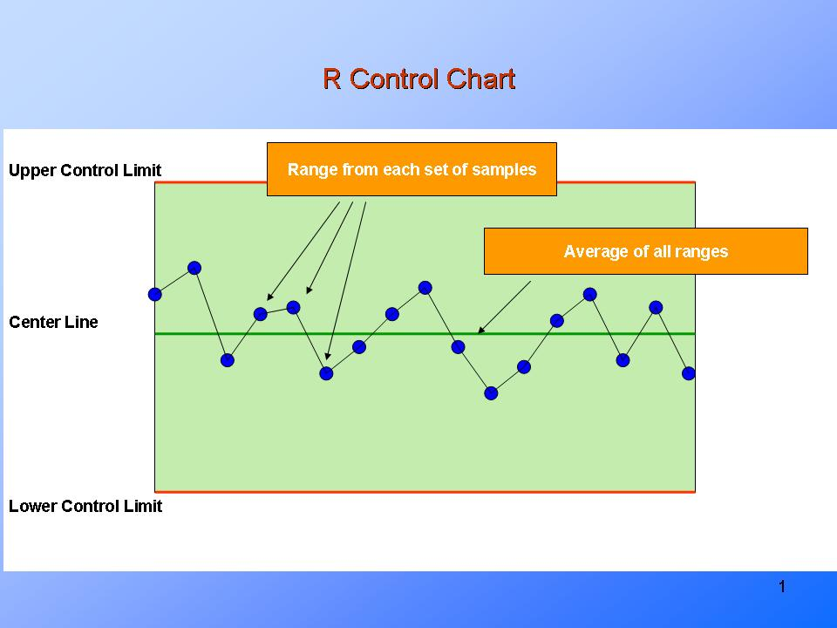
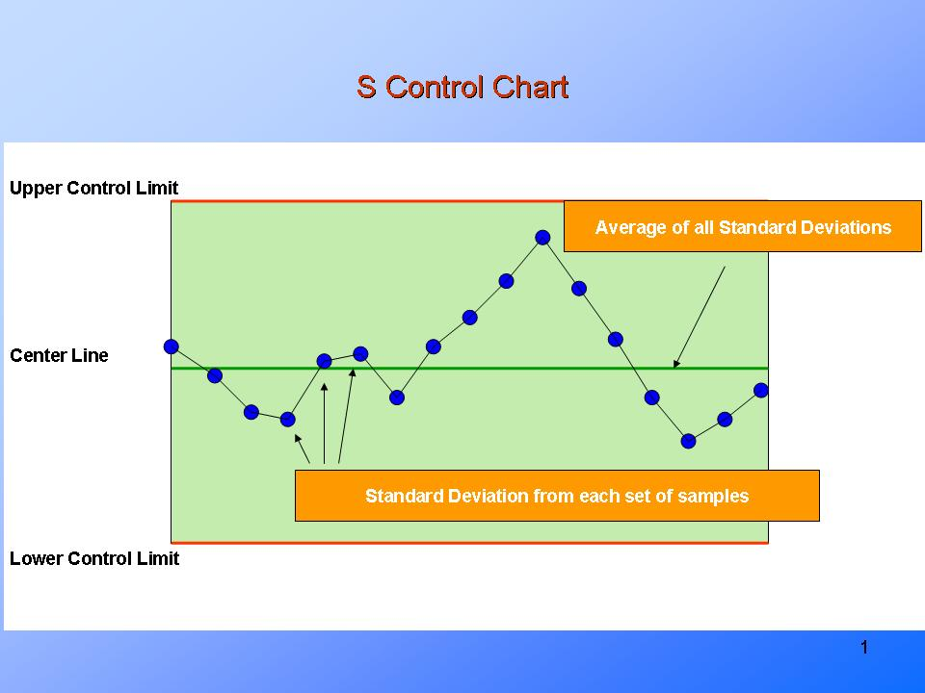

Slide 7
When to use control chart?
To examine whether the process is stable or not.
To understand the process variation over time.
When you need to find out any variation occurs and fixed it instantaneously.
To find out whether the process is within the statistical control or not (Due to chance or assignable causes).

Slide 8
Benefits
Gives the visual representation of the ongoing in a process.
Easy to understand and to interpret.
Helps in decision making for process improvement goals.
Identification of cause’s type of variation in a process.

Slide 9
History of Run chart
Run charts originated from control charts, which were initially designed by Walter Shewhart. Walter Shewhart was a statistician at Bell Telephone Laboratories in New York. Shewhart developed a system for bringing processes into statistical control by developing ideas which would allow for a system to be controlled using control charts. Run charts evolved from the development of these control charts, but run charts focus more on time patterns while a control chart focuses more on acceptable limits of the process. Shewhart's discoveries are the basis of what as known as SQC or Statistical Quality Control.

Slide 10
What is run chart?
A run chart is a line graph of data plotted over time. By collecting and charting data over time, you can find trends or patterns in the process. Because they do not use control limits, run charts cannot tell you if a process is stable. However, they can show you how the process is running. The run chart can be a valuable tool at the beginning of a project, as it reveals important information about a process before you have collected enough data to create reliable control limits.
Usage: Run charts are used to analyze processes according to time or order. Run charts are useful in discovering patterns that occur over time.

Slide 11
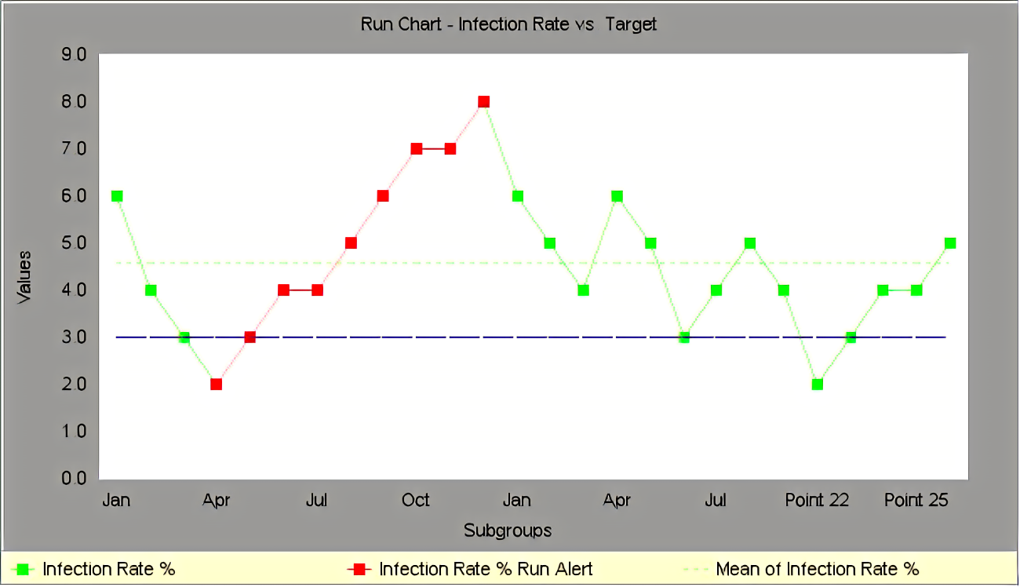
What does it look like?
Run charts show individual data points in chronological order.

Slide 12
Component of a run chart
The Title: It briefly describes the information being displayed on the chart.
Vertical Axis (Y-Axis): This axis is a range that demonstrates the significance of the dimensions represented by data collected
Horizontal (X-Axis): This shows you the time table when the data was collected. This axis will display the progression in which the events being measured take place
Data Points (along with the chart): Each point simply represents an individual measurement
Legend: The legend tells what each line represents. Additional information that documents the data collection should also be here.
Median Value (also called the Centerline): significant if it shows a large number of consecutive values above or below, denotes something to investigate – not random variations in a process
Data Table: This is a listing of the data being shown in the chart.

Slide 13
Interpreting a run chart
Outliers in your chart:
Look for data points that are unusually smaller or larger than other data points on the chart. This is a subjective observation but if you feel any person observing this chart would consider it out of a normal range, then consider this point an outlier.
Trends in your chart:
Trends are defined as a large number (6 or more) of consecutive points all going in the same direction – either up or down. Please note that data points should be increasing or decreasing with each increment. If you have two points that are the same, do not count them in your measurement of a trend.

Slide 14
Interpreting a run chart
Shifts in your chart:
A shift is considered to be six or more consecutive data points that are collected on the same side of the median. These points can be either all above or all below the median. Data points that fall on the median should not be considered as they do not count toward or against creating a shift. You will ignore these points that fall on the median and continue counting.
Runs in your Chart (I also refer to these simply as cross-overs):
A run consists of a number of points, in a row, which occurs on just one side of the median. Under typical circumstances, there should be points crossing the median regularly. If they do not cross, something else may be influencing the data. Data points tend to move above and below the median at regular intervals. If some points fall right on the median line, it can make it difficult to decide if they belong to a run.

Slide 15
End Thank you!

